Slide 1

The Consortium Trust
Professional Development Day
Tuesday 1st September 2020
Health and Safety Briefing
Robin Chew
Head of Service: Facilities and Compliance

Slide 2
The Consortium Trust
Professional Development Day
Tuesday 1st September 2020
Health and Safety Briefing
Contents:
Covid- 19
The duty of care
Compliance and risk assessments
Ofsted and safety
The level of risk in schools
Slips and trips
Home working
COSHH

Slide 3
The Consortium Trust
Professional Development Day – 1st September 2020
COVID-19
By the time you read this the situation will have changed
“As part of planning for full return in the autumn term, it is a legal requirement that schools should revisit and update their risk assessments (building on the learning to date and the practices they have already developed), to consider the additional risks and control measures to enable a return to full capacity in the autumn term.” HM Government
Keep up with current guidance at
  https://www.gov.uk/coronavirus/education-and-childcare
Frequent washing of hands with soap and water is a key health measure in any circumstances

Slide 4
The Consortium Trust
Professional Development Day – 1st September 2020
The employer’s duty of care
“Schools have a primary duty to safeguard the staff and young people in their care while at the same time creating the ‘risk aware, but not risk adverse’ citizens of tomorrow” – RoSPA
The Health and Safety at Work Act of 1974 imposes a duty on all employers to ensure, so far as is reasonably practicable, the health and safety of employees and others (such as school visitors and pupils)
Application of HSWA is based on proportionality: “as far as is reasonably practicable”, not “as far as is possible”
Approved Codes of Practice set out what schools are required to do

Slide 5
The Consortium Trust
Professional Development Day – 1st September 2020
How to stay compliant
Compliance is not achieved by a series of one-off reactions
Compliance comes from sustaining a systematic approach, reviewing risk assessments, checking and testing, and acting on new information
Settings should focus on their most significant risks and be ‘risk led’ not ‘law led’

Slide 6
The Consortium Trust
Professional Development Day – 1st September 2020
Risk Assessments
Schools have a duty to carry out suitable and sufficient risk assessments in accordance with Management of Health and Safety at Work Regulations 1999 for their buildings and activities, including school visits. The risk assessment should detail any risks associated with a facility or activity and what precautions must be taken to minimise any risk.
There are five steps:
    Identify the hazards
    Decide who might be harmed and how
    Evaluate the risks and decide on precautions
    Record your significant findings
    Review your assessment and update if necessary
Point
point

Slide 7
The Consortium Trust
Professional Development Day – 1st September 2020
Ofsted and safety
Both ‘teaching safety’ and ‘teaching safely’ are part of the Framework for School Inspection
In ‘Behaviour and safety of pupils at the school’ inspectors assess ‘whether pupils feel safe and their ability to assess and manage risk appropriately and to keep themselves safe.’
In ‘Quality of leadership in, and management of, the school’ inspectors assess whether leaders and managers ‘take steps to promote the safety of all pupils and ensure that they are safe in school.’

Slide 8
The Consortium Trust
Professional Development Day – 1st September 2020
What are the risks to employees at work?

Slide 9
The Consortium Trust
Professional Development Day – 1st September 2020
69,208 employee non-fatal injuries
reported by employers
in 2018/19
(RIDDOR)

Slide 10
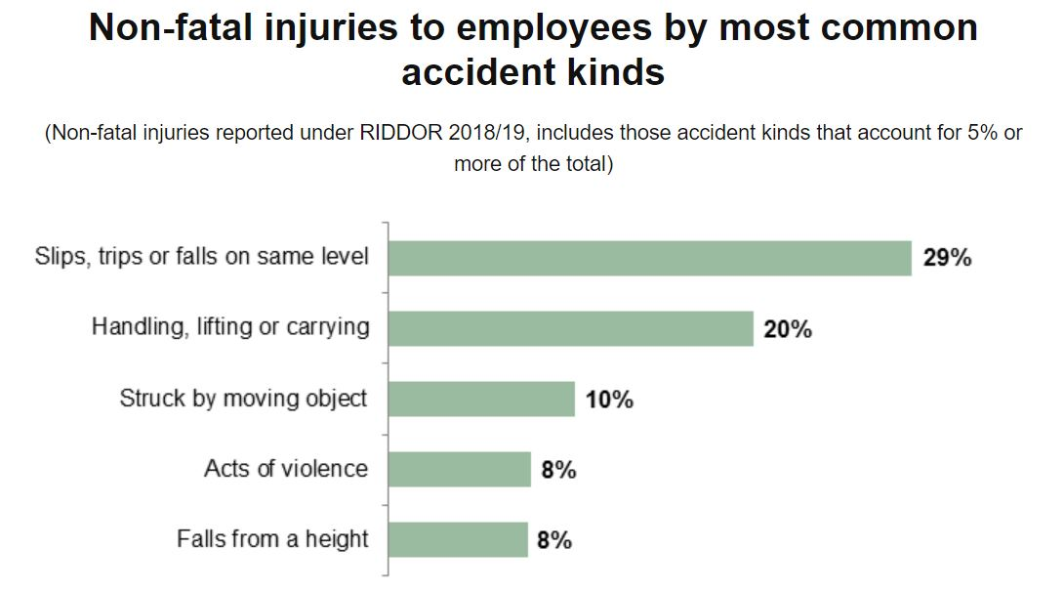
The Consortium Trust
Professional Development Day – 1st September 2020
What are the

Slide 11
The Consortium Trust
Professional Development Day – 1st September 2020
Are schools dangerous?
Fatal injuries are very rare
Number of fatal injuries to workers in Education in 2018/19 = 1
Rate of fatal injury per 100,000 workers in education in 2018/19 = 0.03
(RIDDOR)

Slide 12
The Consortium Trust
Professional Development Day – 1st September 2020
Children are at more a risk than staff
Fatal injuries to non-employees in education settings:
  2014/15 – 4
  2015/16 – 6
  2016/17 – 5
  2017/18 – 1
  2018/19 – 3
(RIDDOR)

Slide 13
The Consortium Trust
Professional Development Day – 1st September 2020
Non-fatal injuries are more frequent
2018/19 – total reported non-fatal injuries to workers in education = 4,568
2,843 of these led to an absence from work of more than 7 days
This translates as 146 non-fatal injuries per 100,000 workers in education
Only 0.15% of education workers had a reported non-fatal injury in that year
                (RIDDOR)

Slide 14
The Consortium Trust
Professional Development Day – 1st September 2020
Slips, trips and falls
Slips and trips account for 55% of all accidents in education (HSE)
About a quarter of these slip and trip accidents in education happened to employees (HSE)
It is therefore important to take steps to prevent such accidents
Use the HSE hazard spotting checklist:
    https://www.hse.gov.uk/pubns/ck4.pdf

Slide 15
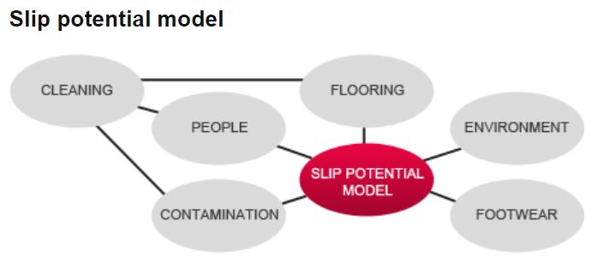
The Consortium Trust
Professional Development Day – 1st September 2020
Slip prevention
The model will help you understand the factors that can contribute to slip accidents and the action needed to take to prevent them

Slide 16
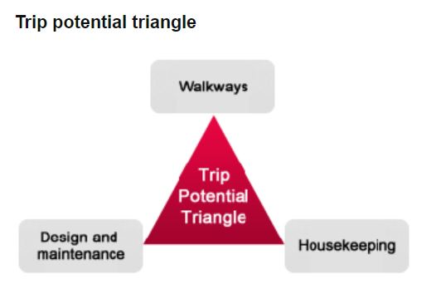
The Consortium Trust
Professional Development Day – 1st September 2020
Trip prevention
The majority of trips are caused by obstructions in walkways. The rest are mostly caused by uneven surfaces

Slide 17
The Consortium Trust
Professional Development Day – 1st September 2020
Trip prevention
Walkways:
Is the walkway being used the most appropriate one available?

Slide 18
The Consortium Trust
Professional Development Day – 1st September 2020
Trip prevention
Housekeeping:
Is the walkway being kept clear and clean?

Slide 19
The Consortium Trust
Professional Development Day – 1st September 2020
Trip prevention
Design and maintenance:
Is the surface suitable and well maintained?
Are stairs suitable with sufficient handrails?
Is lighting sufficient?

Slide 20
The Consortium Trust
Professional Development Day – 1st September 2020
Home working
Some staff may continue to work from home for some of the time
Employers have the same health and safety responsibilities to home workers
Be aware of the risks of lone working and the need to remain in communication to monitor workers’ wellbeing
Carry out a Display Screen Equipment assessment of your home workstation

Slide 21
The Consortium Trust
Professional Development Day – 1st September 2020
COSHH – Control of substances hazardous
To health
The law requires employers to control substances that are hazardous to health. Many cleaning and other products can be harmful. You can prevent or reduce workers exposure to hazardous substances by:
finding out what the health hazards are
deciding how to prevent harm to health ( through a risk assessment)
providing control measures to reduce harm to health
making sure they are used
keeping all control measures in good working order
providing information, instruction and training for employees and others
providing monitoring and health surveillance in appropriate cases
planning for emergencies

Slide 22
The Consortium Trust
Professional Development Day – 1st September 2020
Chemical safety data sheets
They provide information on chemical products that help users of those chemicals to make a risk assessment – they are not a risk assessment in themselves
Use the sheets to adopt exposure control measures

Slide 23
The Consortium Trust
Professional Development Day – 1st September 2020
COSHH control measures
Choosing control measures (In order of priority):
1 Eliminate the use of a harmful product or substance and use a safer one.
2 Use a safer form of the product, e.g. paste rather than powder.
3 Change the process to emit less of the substance.
4 Enclose the process so that the product does not escape.
5 Extract emissions of the substance near the source.
6 Have as few workers in harm’s way as possible.
7 Provide personal protective equipment (PPE) such as gloves, coveralls and a
respirator. PPE must fit the wearer.
If your control measures include 5, 6 and 7, make sure they all work together.

Slide 24
The Consortium Trust
Professional Development Day – 1st September 2020
Thank you

