Slide 1
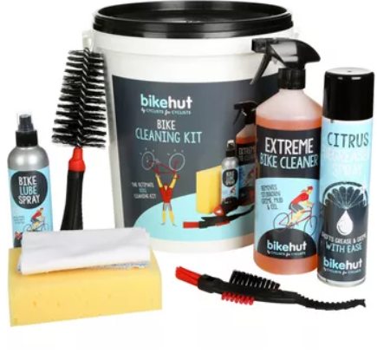
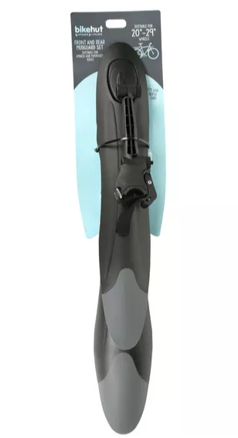
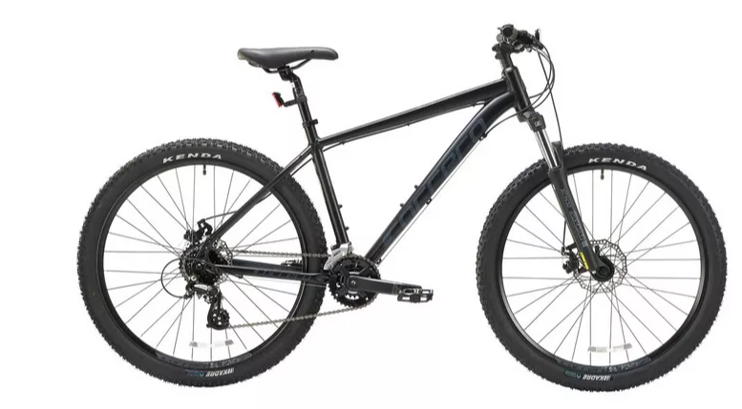
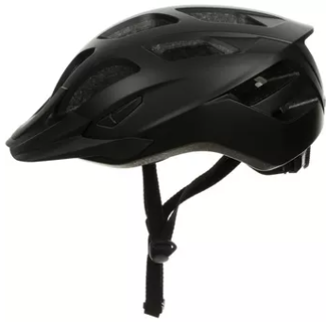
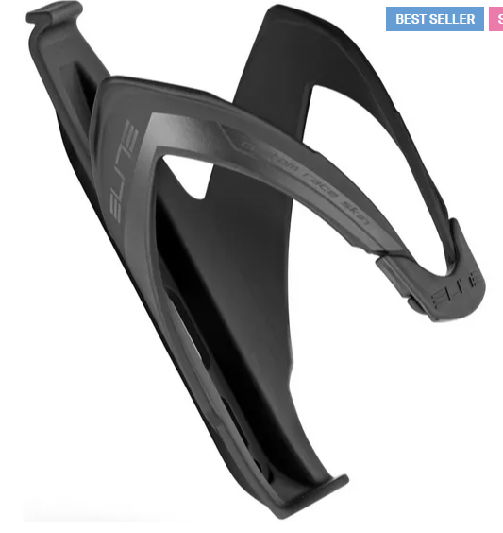
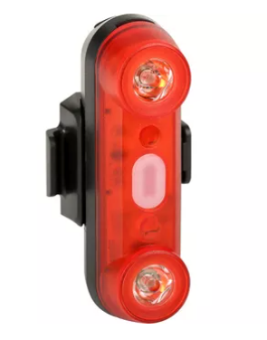
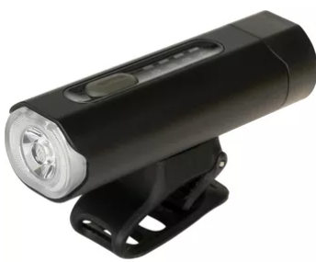
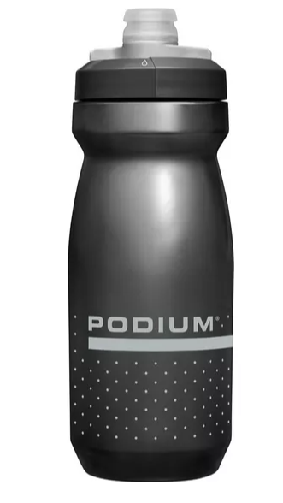
Up to £500 Mountain Bike
Carrera Vengeance £370
The UK’s best selling mountain bike, complete with disc brakes and reliable Shimano Altus gearing. The Vengeance is always up to the task at hand
Item code - 340910
Bundle Price £500
Halfords Cleaning Bucket £20
Item code 537123
Halfords front and rear mudguard set £20
Quick and easy to install with the rear featuring a quick release strap with adjustable arm, meaning you are covered at all times
Item code - 572526
Halfords Trail Helmet £25
Lightweight with adjustable fit and sealed padding ensuring safety and comfort
Item code 250822
Elite custom Race Bottle Cage £9
This lightweight and sleek bottle cage easily attaches to your bike using bottle cage bolts or straps
Item code - 207560
Halfords 50 Lumen Rear Bike Light £10
USB rechargeable and easy to attach, be seen anywhere
Item code - 253294
Halfords Advanced 500 Lumen Front Bike Light £29.99
USB rechargeable and easy to install, this light is perfect for commutes
Item code - 253318
Camelbak Podium £10.99
Designed to fit bottle cages better and complete with hydroguard mouthpiece
Item code - 630318

Slide 2

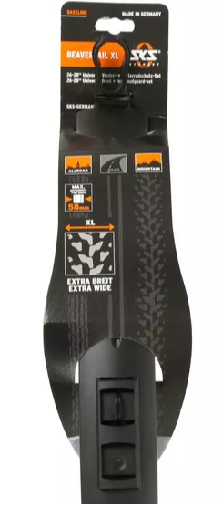
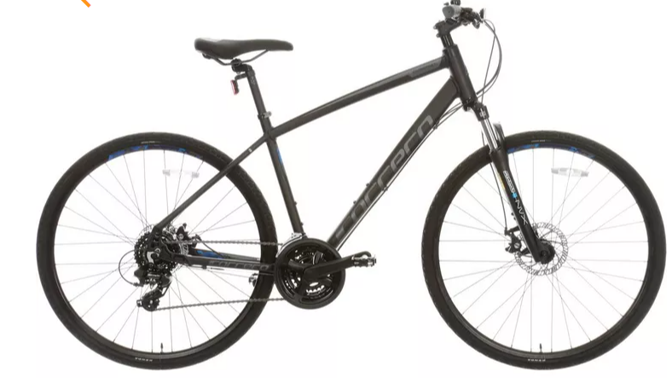
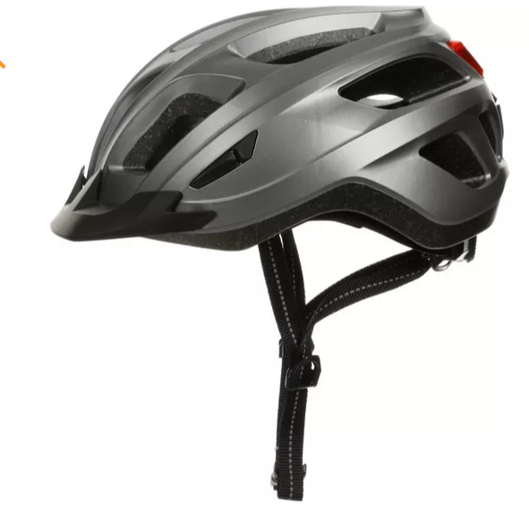
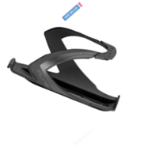
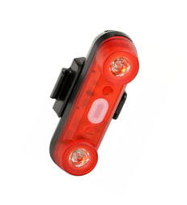
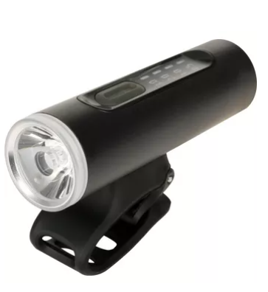
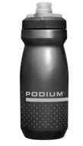
Up to £500 Hybrid Bike
Carrera Crossfire 2 £370
Complete with disc brakes, Shimano gearing and front suspension the Crossfire 2 is the ideal hybrid to get you on your way
Item code - 345886
Bundle Price £497
Halfords Cleaning Bucket £20
Item code 537123
SKS Beavertail XL Mudguards £17
Clip on mudguard with steel brackets offering perfect coverage for thinner tyres
Item code - 118046
Halfords Commute Helmet £35
Lightweight with adjustable fit and complete with rear light, perfect for commuting
Item code 252702
Elite custom Race Bottle Cage £9
This lightweight and sleek bottle cage easily attaches to your bike using bottle cage bolts or straps
Item code - 207560
Halfords 50 Lumen Rear Bike Light £10
USB rechargeable and easy to attach, be seen anywhere
Item code - 253294
Halfords 200 Lumen Front Light £19.99
Perfect choice for urban commuting with 8 lighting modes and USB rechargeable
Item code - 253302
Camelbak Podium £10.99
Designed to fit bottle cages better and complete with hydroguard mouthpiece
Item code - 630318

Slide 3
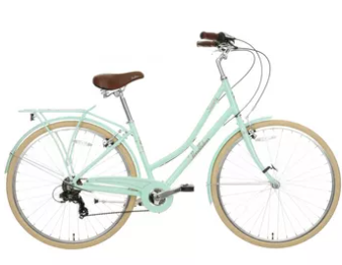
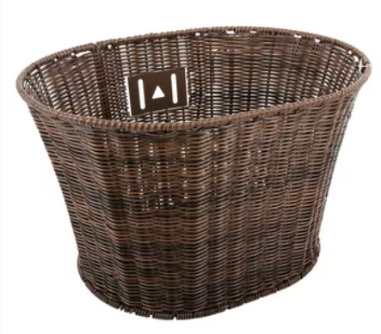
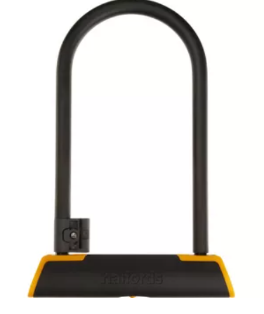
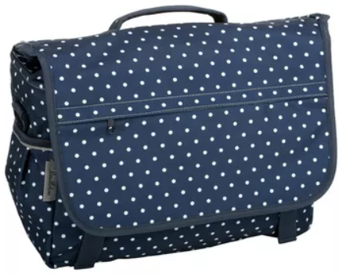
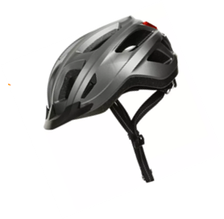
Up to £500 Classic Bike
Pendleton Somerby Mint £320
With it’s classic step through frame and vintage styling the Pendleton Somerby is the personification of style
Item code - 507514
Bundle Price £455
Pendleton Wicker basket £40
Style meets practicality with the Pendleton wicker basket
Item code - 372034
Halfords 23cm D Lock £30
Gold sold secure rating with an anti pick lock
Item code - 225374
Pendleton Messenger Bag £30
The perfect accessory to your vintage bike
Item code - 554763
Halfords Commute Helmet £35
Lightweight with adjustable fit and complete with rear light, perfect for commuting
Item code 252702

Slide 4
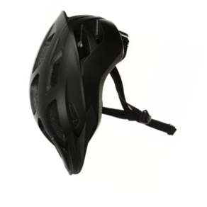
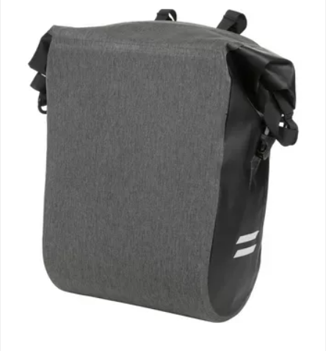
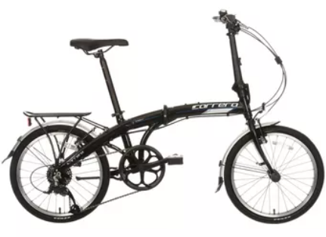
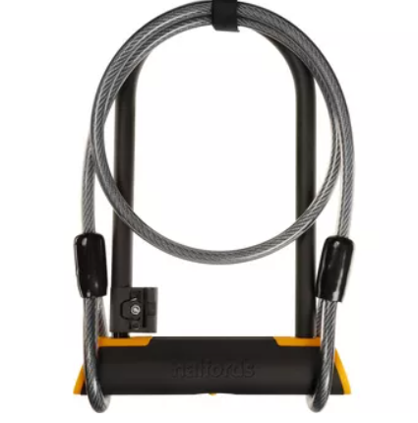
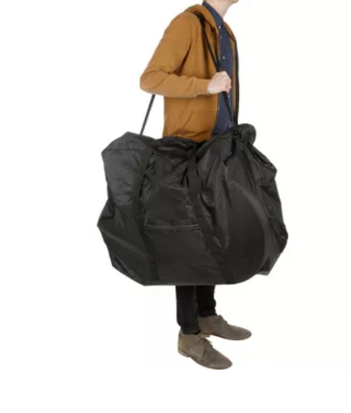

Up to £500 Folding Bike
Carrera Intercity Limited £375
With it’s classic step through frame and vintage styling the Pendleton Somerby is the personification of style
Item code - 507514
Bundle Price £500
Halfords Advanced Waterproof Pannier Bag £30
Designed with commuters in mind, fully waterproof and featuring quick release mounts
Item code - 184710
Halfords Trail Helmet £25
Lightweight with adjustable fit and sealed padding ensuring safety and comfort
Item code 250822
Halfords Folding Bike Bag £20
Convenient way to transport your folding bike
Item code - 213142
Halfords 23cm D lock with 115cm cable £40
Gold sold secure anti pick lock with additional flex cable
Item code - 225470
Halfords Mini Cleaning Kit £10
This kit contains your bike cleaning essentials
Item code - 732135

Slide 5
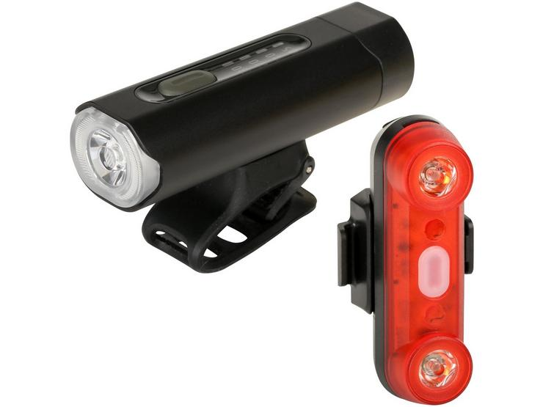
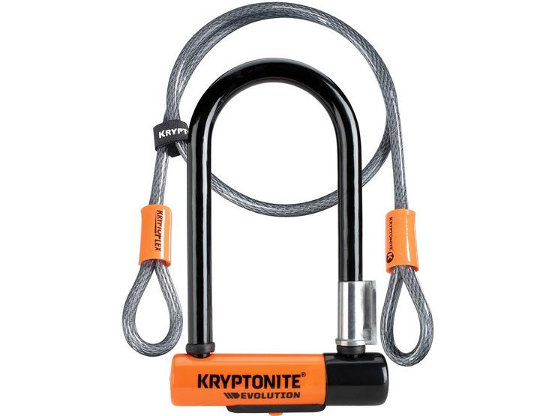
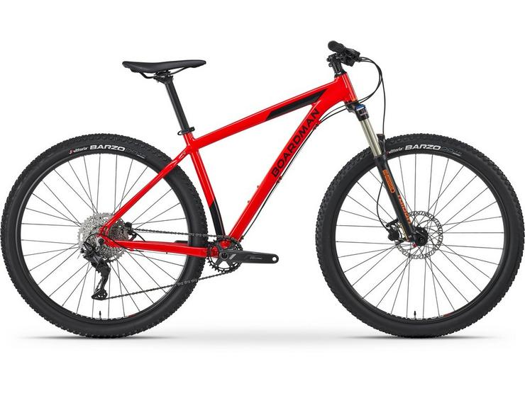
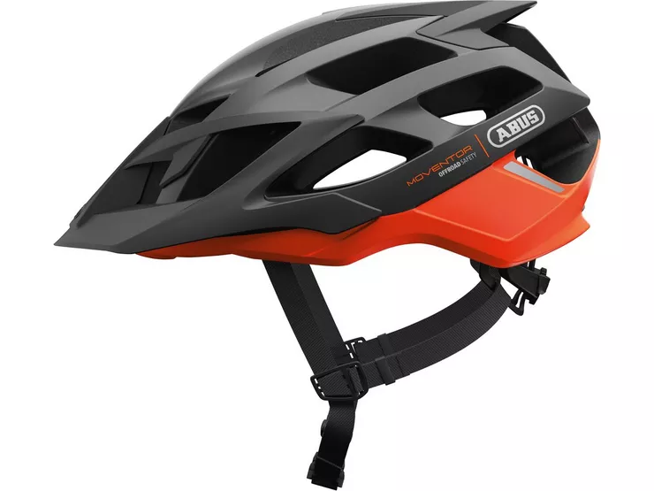
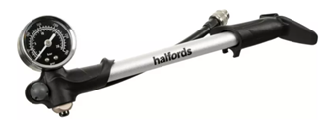
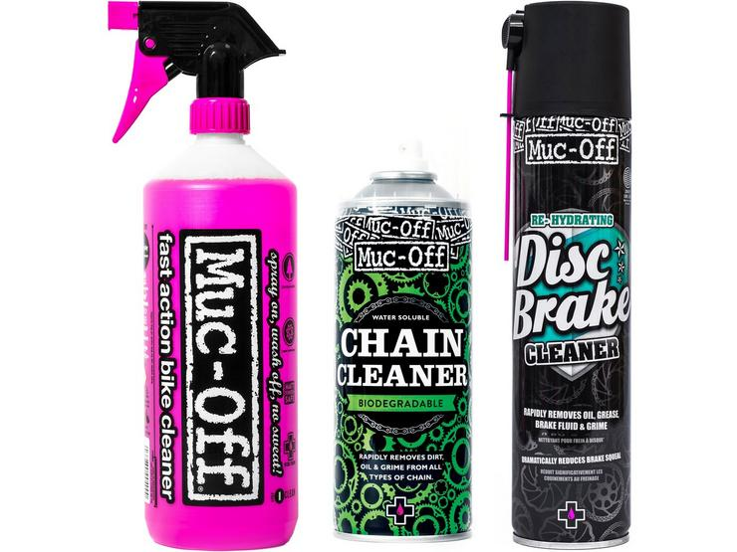
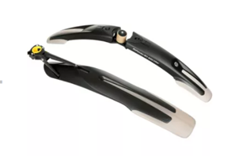
Up to £1000 Mountain Bike
£700 Boardman MHT 8.6 Men’s Mountain Bike
The bike adopts a trail ready geometry, Longer and slacker, the frame is designed to give a reassuring level of stability as you push down runs.
£54.99 Halfords Advanced 500 Lumen Front Bike Light & Halfords 50 Lumen Rear Bike Light 253318/ 253294
£69.99 Kryptonite Evolution Mini 7 D Lock With 4 Foot Cable 581667
Halfords Suspension Shock Pump £20
A must have to get your air suspension set up correctly
Item code - 284750
From £62.13 ABUS Helmet Moventor Helmet 206270
Topeak Defender Set £40
Keep both you and your ride clean at all times
Item code - 703161
£19.98 Muc-Off Bike Cleaning Bundle, 805671/805614/414664
Bundle Price £957

Slide 6
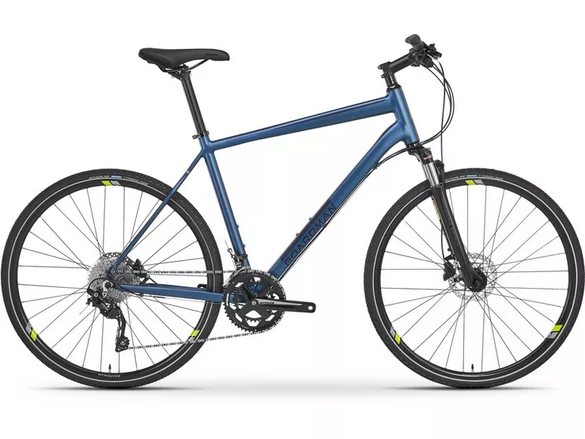
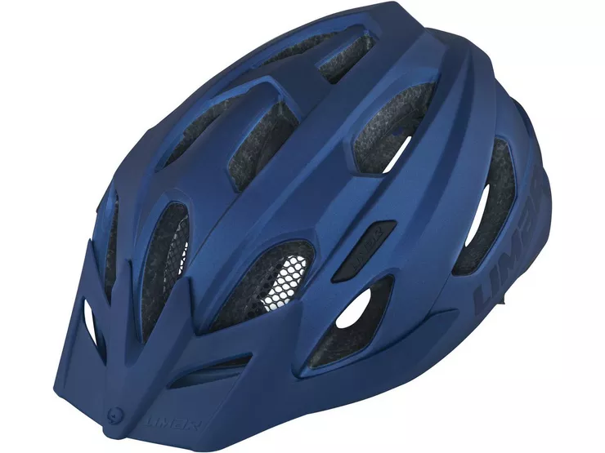
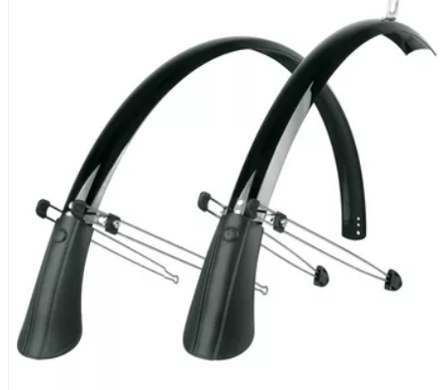
Up to £1000 Hybrid Bike
£725 Boardman MTX 8.8 Men’s Hybrid Bike
Based on the previous generation’s flagship model, the MTX 8.8 is a leisure hybrid that is as equally at home on and off the road. The MTX 8.8 is one bike you can rely on for any adventure.
£54.99 Halfords Advanced 500 Lumen Front Bike Light & Halfords 50 Lumen Rear Bike Light 253318/ 253294
£69.99 Kryptonite Evolution Mini 7 D Lock With 4 Foot Cable 581667
£25 SKS Commuter mudguards 448990
£59.99 Limar Urbe Helmet
186286
£19.98 Muc-Off Bike Cleaning Bundle, 805671/805614/414664
Bundle Price £945

Slide 7
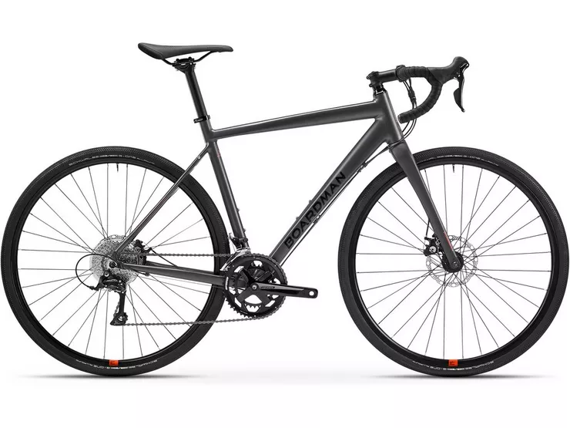

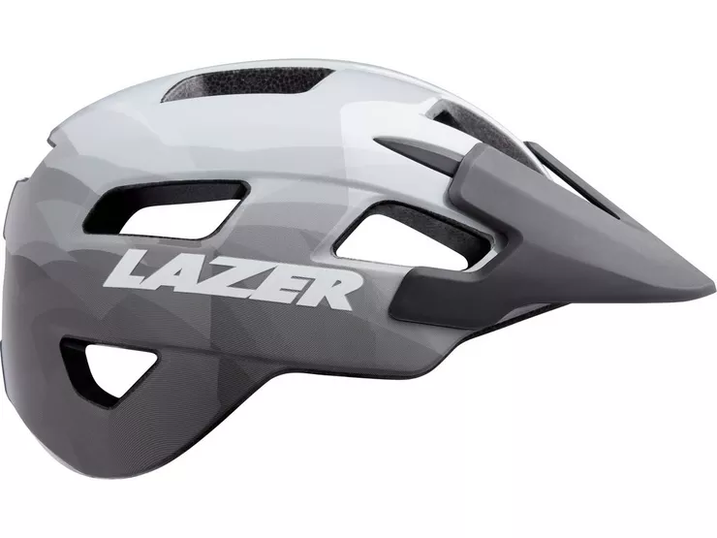
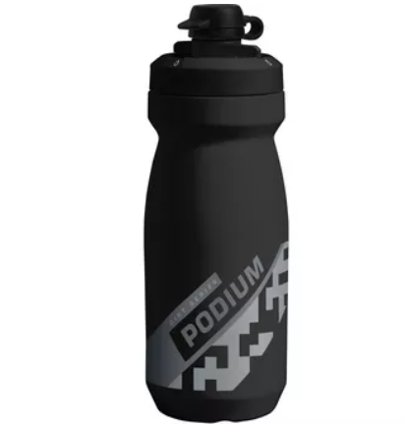
Up to £1000 Adventure Bike
£775 Boardman ADV 8.6 Men’s Adventure Bike
The ADV 8.6 is Boardman’s entry level Adventure bike. Its comfortable geometry and go-anywhere design mean you can count on it no matter where you plan to ride
£54.99 Halfords Advanced 500 Lumen Front Bike Light & Halfords 50 Lumen Rear Bike Light 253318/ 253294
£69.99 Kryptonite Evolution Mini 7 D Lock With 4 Foot Cable 581667
Elite custom Race Bottle Cage £9
This lightweight and sleek bottle cage easily attaches to your bike using bottle cage bolts or straps
Item code - 207560
Camelbak Podium Dirt £13
Item code - 796669
£40 Lazer Chiru Helmet254286
£19.98 Muc-Off Bike Cleaning Bundle, 805671/805614/414664
Bundle Price £972

Slide 8
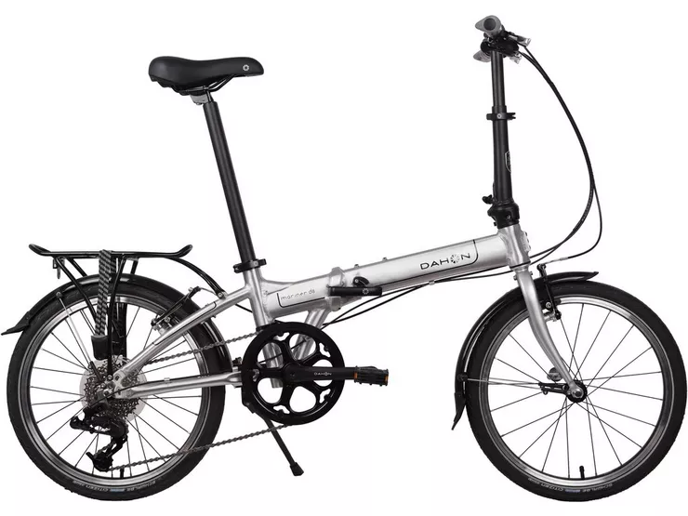
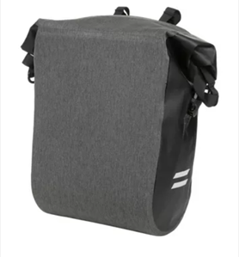
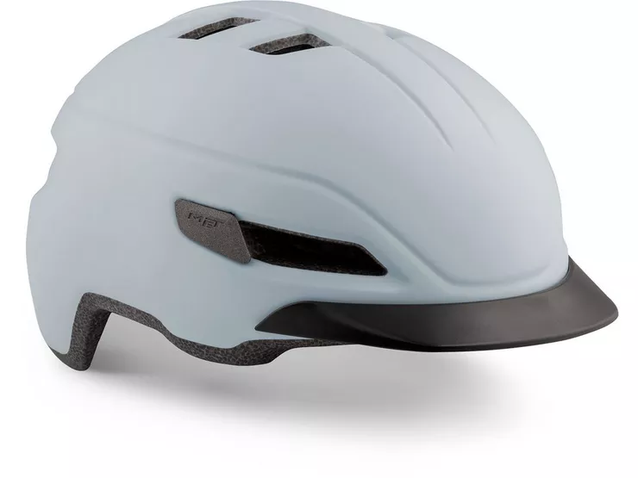
Up to £1000 Folding Bike
£750 Dahon Mariner D8 Folding Bike A frequent winner of folding bike shootouts that include bikes that cost up to four times as much, It’s a high quality, lightweight bike at a surprisingly affordable price.
£54.99 Halfords Advanced 500 Lumen Front Bike Light & Halfords 50 Lumen Rear Bike Light 253318/ 253294
£69.99 Kryptonite Evolution Mini 7 D Lock With 4 Foot Cable 581667
Halfords Advanced Waterproof Pannier Bag £30
Designed with commuters in mind, fully waterproof and featuring quick release mounts
Item code - 184710
Met Corso Helmet546878 £60.00
£19.98 Muc-Off Bike Cleaning Bundle, 805671/805614/414664
Bundle Price £975

Slide 9
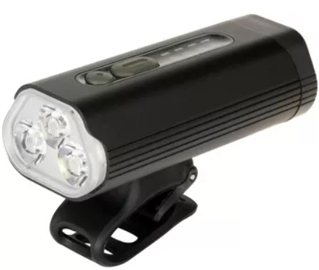
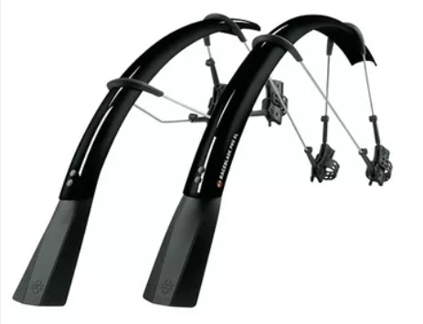
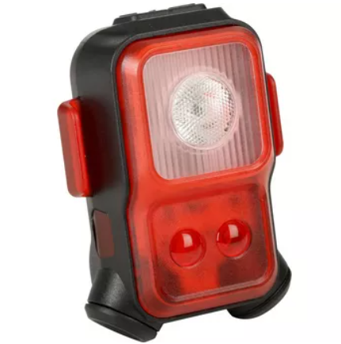
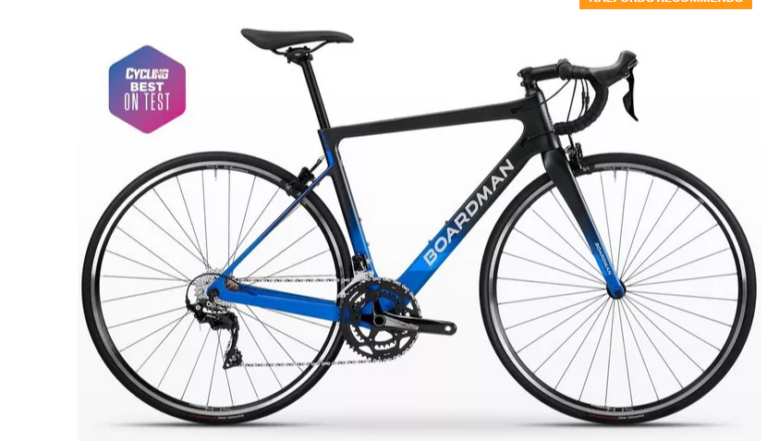
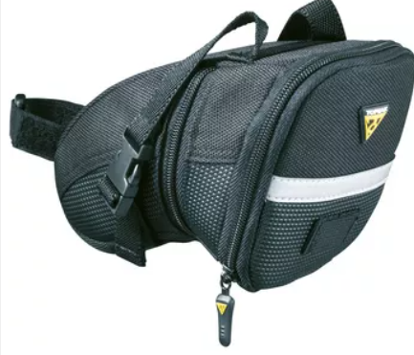
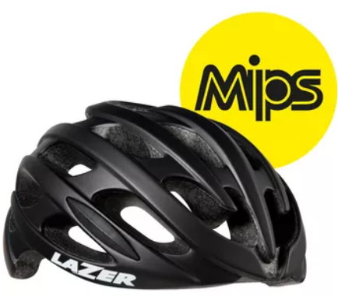
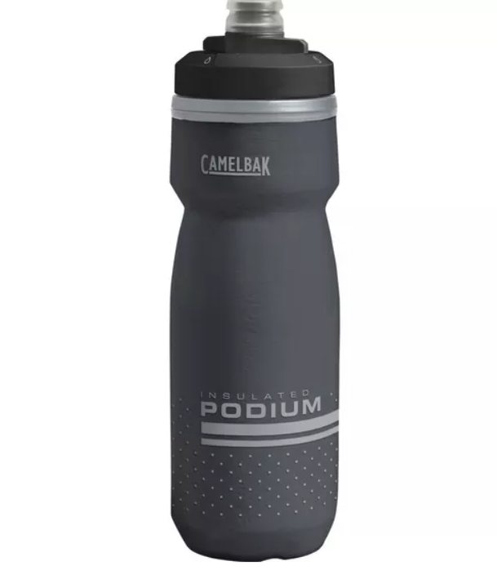
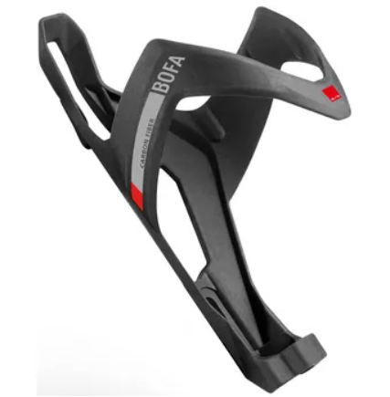
Up to £1500 Road Bike
Boardman SLR 8.9 £1,150
Boardman’s incredible carbon road bike with 11 speed Shimano 105 gears and agile Vittoria Rubino Pro IV tyres
WItem code - 365462
Bundle Price £1397
Halfords Advanced 1600 Lumen Bike Light £59.99
Item code - 253334
SKS Raceblade Pro £38.99
These mudguards help keep your bike sleek and you clean
Item code - 264496
Halfords 100 Lumen rear laser light £25
Item code - 253326
Lazer Blade+ MIPS £75
Well ventilated and complete with additional MIPS protection
Item code - 128462
Elite Carbon Bofa £19.99
Low weight meets high strength
Item code - 113966
Topeak Wedge Aero £13
Ideal way to keep your essentials neatly out of the way
Item code - 565103
Camelbak Podium Chill £14.99
Insulated layer keeps your drink cooler for longer
Item code - 791677

Slide 10

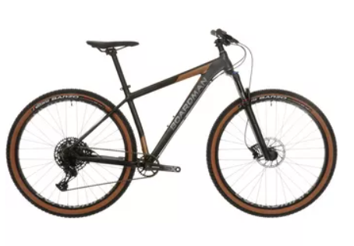





Up to £1500 Mountain Bike
Boardman MHT 8.9 £1,050
A perfect single track companion complete with Rockshox Reba forks and a Sram Eagle drivetrain
Item code - 189326
Bundle Price £1375
Stans No Tube MTB Tubless Kit £35
Item code - 852886
Lazer Coyote MIPS £75
Well ventilated and complete with additional MIPS protection
Item code - 254518
Topeak Joe Blow Sport III £45
Item code - 545399
Satori Sorata Pro Dropper Post £110
Improve your commute with a dropper post, increasing comfort and practicality
Item code - 439710
Halfords Suspension Shock Pump £20
A must have to get your air suspension set up correctly
Item code - 284750
Topeak Defender Set £40
Keep both you and your ride clean at all times
Item code - 703161

Slide 11



Up to £1500 eBike
£1099 Carrera Vengeance E Mens Electric Mountain Bike 2.0
Sharing its foundations with our best-selling mountain bike, the Carrera Vengeance E Mens Electric Mountain Bike 2.0 offers capability with added assistance. The 317Wh battery has a range of up to 40 miles to help you stay at your best, and a charge time of 6 hours meaning it can easily be topped up overnight. When you need it, the rear hub motor delivers speeds up to 15.5mph without compromising traction.
£54.99 Halfords Advanced 500 Lumen Front Bike Light & Halfords 50 Lumen Rear Bike Light 253318/ 253294
£100 Abus Granit XPlus 540 D-Lock 333574
Topeak Defender Set £40
Keep both you and your ride clean at all times
Item code - 703161
£60 Lazer Chiru MIPS Helmet254374
£19.98 Muc-Off Bike Cleaning Bundle, 805671/805614/414664
Bundle Price £1364

Slide 12




Up to £1500 eBike
£1049 Pendleton Somerby-E Electric Hybrid Bike
All the style of the Pendleton Somerby with added, electrically powered, pedal assistance. The 317Wh battery delivers up to 50 miles of range through a rear reliable Bafang hub motor with speed sensor. This extra power is enough to guarantee effortless rides, taking the strain out of hills and making moving off from a standstill much easier.
£54.99 Halfords Advanced 500 Lumen Front Bike Light & Halfords 50 Lumen Rear Bike Light 253318/ 253294
£100 Abus Granit XPlus 540 D-Lock 333574
Pendleton Messenger Bag £30
The perfect accessory to your vintage bike
Item code - 554763
£89 Kask Moebius WG11 Urban Helmet 537158
Pendleton Wicker basket £40
Style meets practicality with the Pendleton wicker basket
Item code - 372034
£19.98 Muc-Off Bike Cleaning Bundle, 805671/805614/414664
Bundle Price £1373

Slide 13




Up to £1500 eBike
£1399 Carrera Crossfire E Mens Electric Hybrid Bike 2.0
Take the strain out of your daily commute or weekend outing with the Carrera Crossfire E 2.0. On a single charge the 417Wh battery provides up to 60 miles of pedalling assistance and will propel you on to speeds of 15.5mph. The Suntour Performance rear hub motor with premium cadence sensor offers 4 levels of assistance – Turbo, Tour, Sport and Eco – so you will have the power you need exactly when you need it.
Halfords 23cm D lock with 115cm cable £40
Gold sold secure anti pick lock with additional flex cable
Item code - 225470
Halfords Advanced 500 Lumen Front Bike Light £29.99
USB rechargeable and easy to install, this light is perfect for commutes
Item code - 253318
Halfords 25 Lumen Rear Bike Light £10
Item code - 252694
£19.98 Muc-Off Bike Cleaning Bundle, 805671/805614/414664
Bundle Price £1499

